Slide 1
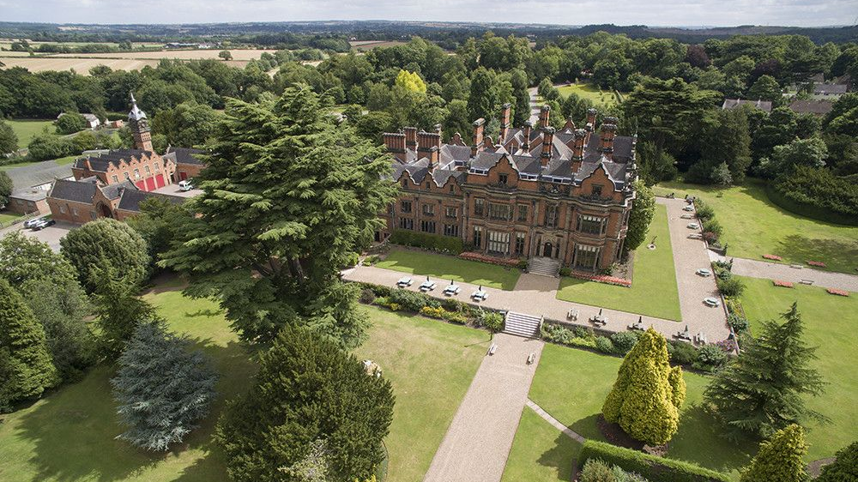

Beaumanor 2024
8 – 12th July
Arrangements for the Week
Parent and Carer Information

Slide 2
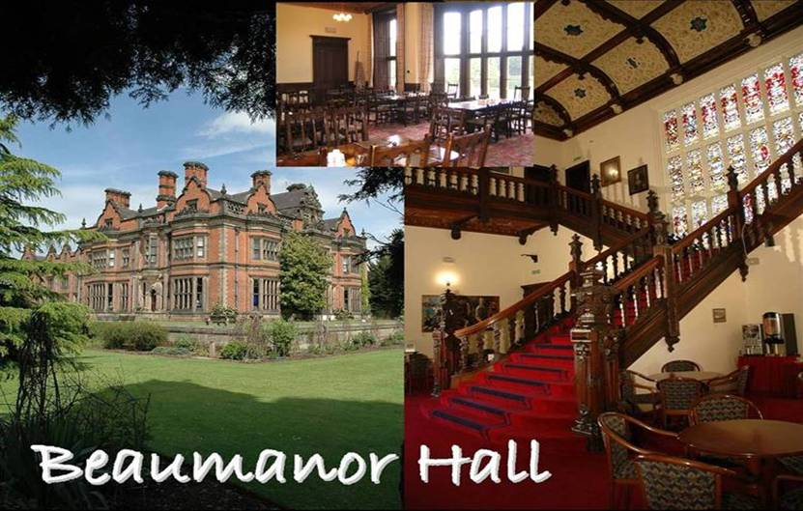
Beaumanor Outdoor Learning Centre
Notes:
Beaumanor Outdoor Learning Centre is Leicestershire County Council’s outdoor education provision.
Some views of the hall, showing the Victorian grandeur of the interior staircase. Also, a shot of the dining hall where the pupils will have their evening meals.

Slide 3
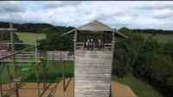
Beaumanor Outdoor Learning Centre
Beaumanor Hall Activities - YouTube
https://www.youtube.com/watch?v=ft9U1z5aAkI
Notes:
Beaumanor Outdoor Learning Centre is Leicestershire County Council’s outdoor education provision.
Some views of the hall, showing the Victorian grandeur of the interior staircase. Also, a shot of the dining hall where the pupils will have their evening meals.

Slide 4
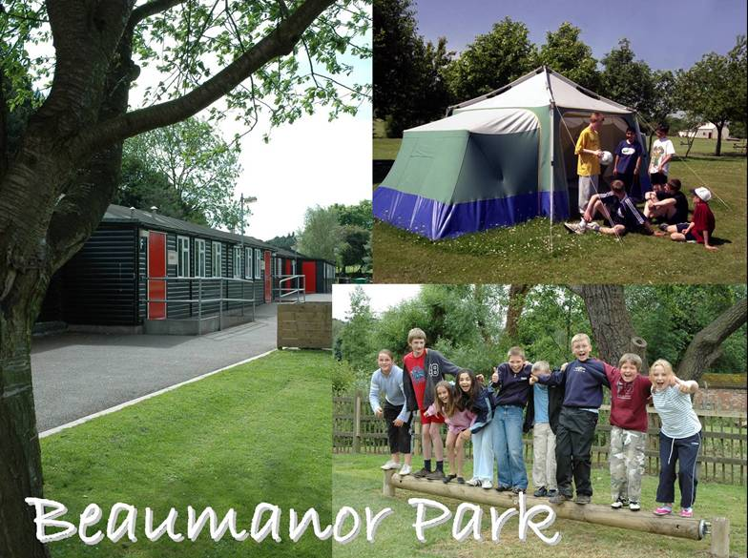
Notes:
Some views of the ‘Park’. A picture of the cabins and the grounds. Sometimes there are campers, so a standing camp is set up in the summer term.

Slide 5
Residential Experience
SOME BENEFITS
Enriches the curriculum
Provides real-world learning
Pupils explore their own potential
Increases self-confidence and resilience
Promotes teamwork and independence
Pupils learn to manage risk
Relationship building
Notes:
The staff at Beaumanor believe passionately in the value of Outdoor Education and the benefits high quality outdoor learning can contribute to a young persons education. We will always try and work with schools to ensure the experiences we deliver to young people make a positive contribution to the school based curriculum.

Slide 6
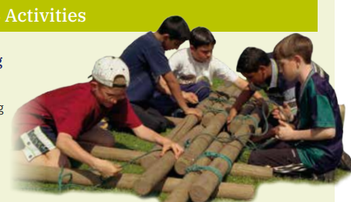
Introduction Activities
This is a series of team activities designed to familiarise the group with the staff, site and what lies ahead, preparing them for challenge, adventure, working together and fun.
Notes:
This is a series of team activities designed to familiarise the group with the staff, site and what lies ahead, preparing them for challenge, adventure, working together and fun.

Slide 7
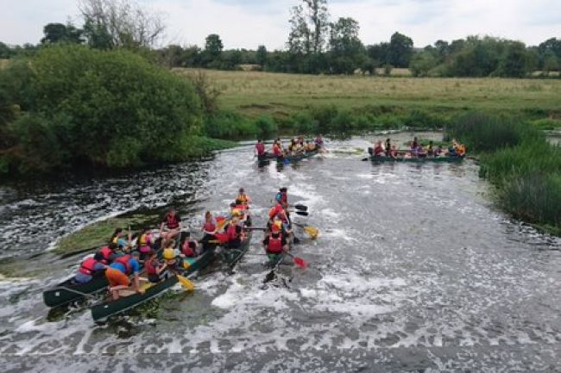
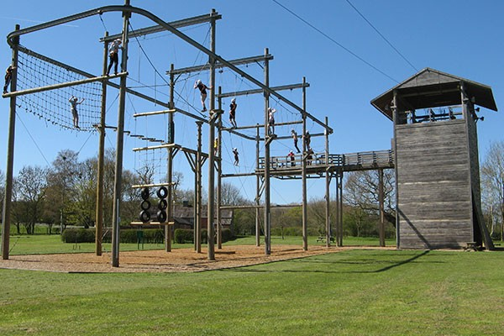
Main Activities
Notes:
This is a series of team activities designed to familiarise the group with the staff, site and what lies ahead, preparing them for challenge, adventure, working together and fun.

Slide 8
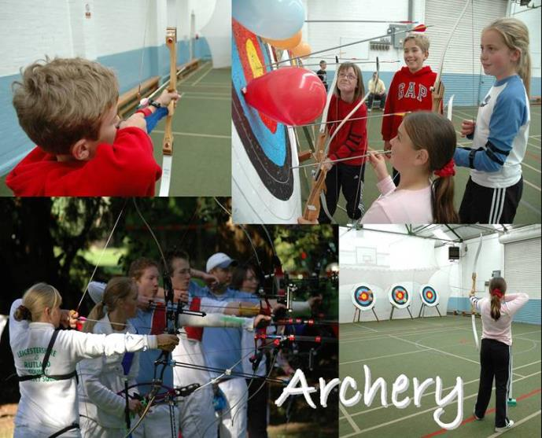
Technical skills
Knowledge
Games
Team competition
Life skills
Notes:
Beaumanor has both indoor and outdoor archery ranges.
All instructors have been CRB checked. All instructors have relevant National Governing Body qualifications to be able to deliver the adventure activities.
The activities your children will do:
Archery

Slide 9
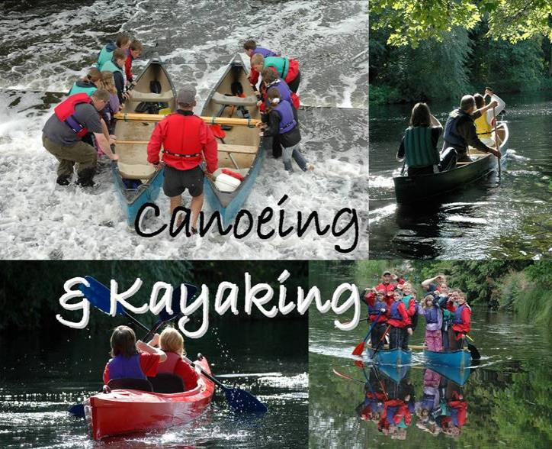
Technical skills
Knowledge
Teamwork
Journeying
Challenge
Notes:
Canoeing is based at Proctors. You will be taken there by minibus.

Slide 10
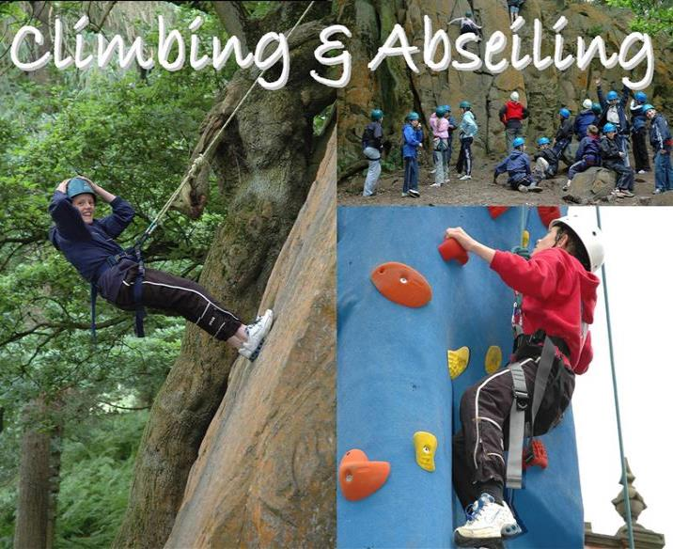
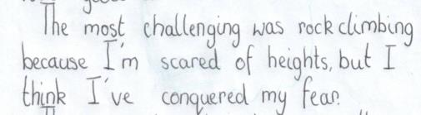
Technical skills
Knowledge
Safety
Personal Challenge
Life skills
Notes:
Climbing can take place on the indoor wall or on the walls on the High Ropes Tower. Children learn the basics in climbing and may do some paired belaying, where they support each other. This activity requires both believe in oneself and trust in others.

Slide 11
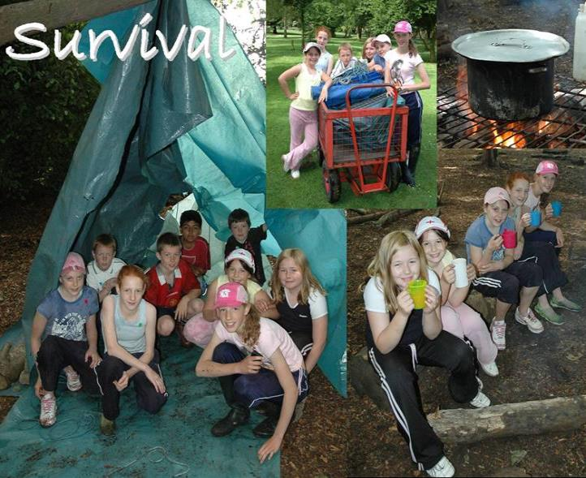
Problem Solving
Safety
Teamwork
Life skills
Knowledge
Achievement
Notes:
The children will be given the task of building a water-tight shelter in the woods at Beaumanor. Their instructor will throw a bucket of water on to their shelter to see how successfully the task has been completed. The activity calls upon students design skills and the ability to work as part of a team. The essentials for survival will be explored and how these requirements might be met.
They will then have some soup around a campfire.

Slide 12
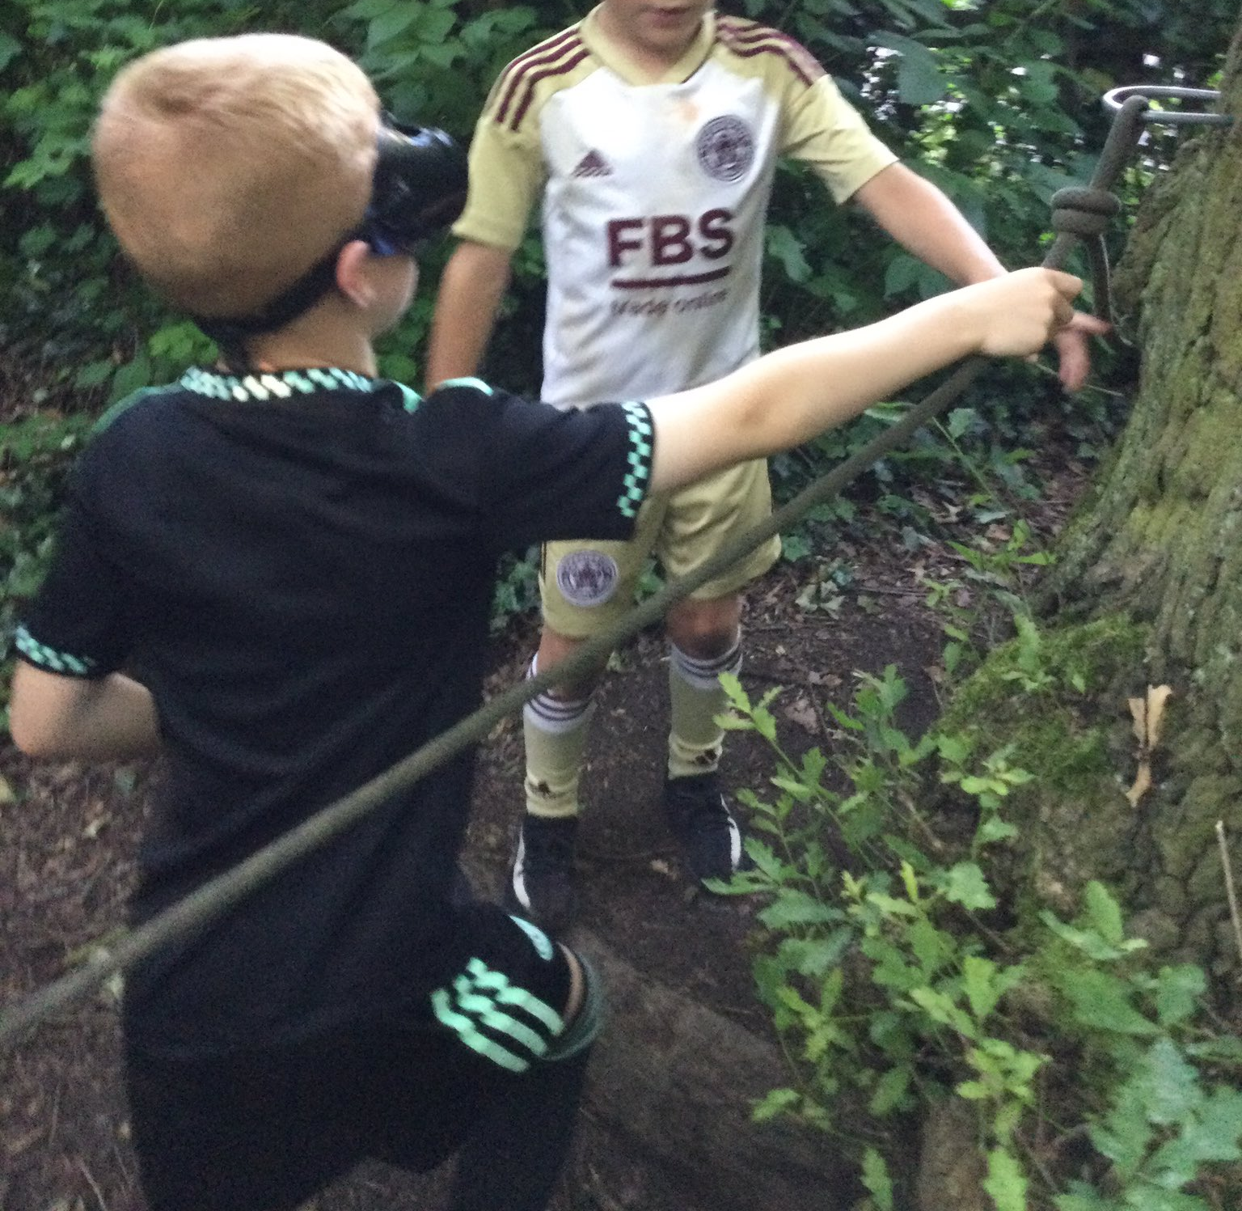
Nightline
Teamwork
Trust
Sensory exploration
Communication
Problem solving
Fun

Slide 13
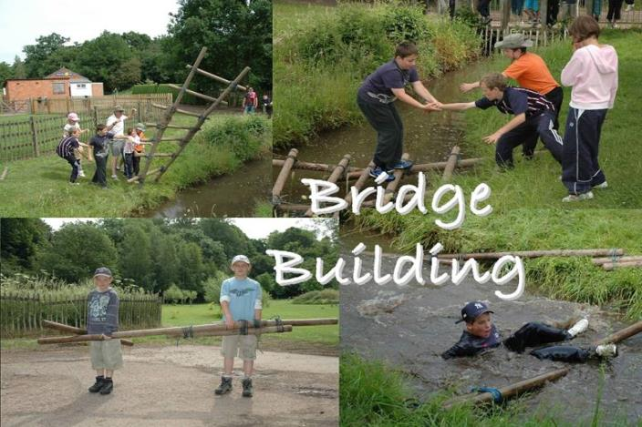
Problem Solving
Safety
Teamwork
Life skills
Knowledge
Achievement
Notes:
Working in small groups will construct a bridge consisting of wooden poles and ropes. The bridge is then used to cross the stream, ideally without without falling in!
They will be taught a selection of knots and lashings to enable them to build safe structures.
It is an exercise calling for leadership, co-operation, planning and design skills.

Slide 14
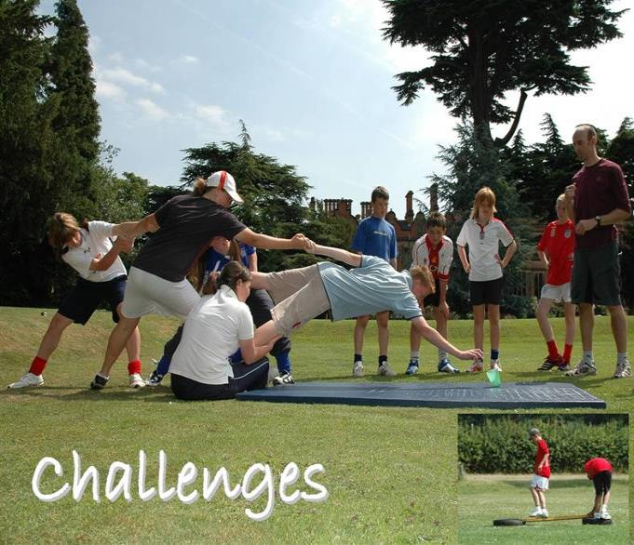
Problem Solving
Safety
Teambuilding
Life skills
Knowledge
Achievement
Notes:
The group will take part in a series of challenges that will help them use their team working skills. This is physical and mentally challenging session.

Slide 15
Safety
Personal Challenge
Life skills
Thrill
Achievement
Notes:
The young people ( and group leaders!) will be encouraged to attempt the aerial trek, an obstacle course 6 metres off the ground, and have a go on the zip wire. This is an exhilarating experience and the participants will gain a great sense of personal development from this.

Slide 16
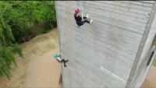
https://www.youtube.com/watch?v=Dr-WN40X_3w
Safety
Personal Challenge
Life skills
Thrill
Achievement
ADHD Solutions - Summer Activities 2022 - Beaumanor Hall High Ropes (youtube.com)
Notes:
The young people ( and group leaders!) will be encouraged to attempt the aerial trek, an obstacle course 6 metres off the ground, and have a go on the zip wire. This is an exhilarating experience and the participants will gain a great sense of personal development from this.

Slide 17
Pupil FAQs

Slide 18
Q. Do I have to go to Beaumanor?
A. No, but most pupils will!
There will be a fun week of activities in store for the pupils who do not go to Beaumanor, but on average, around 90% - 95% of the year group go each year.
There are 295 pupils in year 7; therefore, we are expecting around 270 – 275 pupils to attend this year.
Over 260 pupils have now signed up for this year!

Slide 19
Q. Do I have to camp in a tent?
A. No, but most pupils will!
Part of the fun for most pupils (and many staff) is camping for the week; therefore, we anticipate that most pupils will want to do so.
However, there are approximately 100 cabin/dorm spaces available for pupils who do not wish to camp.
If your parent or carer contacts Mr Knight, he can put your name down for a cabin.

Slide 20
Q. If I camp, who do I camp with?
This is up to you, but there are a few rules.
- We are asking that you camp in a group of three to a four-person tent
- We are asking that you have a four-person tent, so there is enough space to store your belongings.
- Groups must be of the same gender, but they can be from any form
- You need to have practiced putting up the tent by yourself (staff will help, though).
- You will need to provide your own tent
- Assistance with sourcing a tent may be possible in some cases if no one in your group of three has one.

Slide 21
Q Can I bring my mobile phone?
No, and there are several good reasons for this.
- E-safety is of paramount importance, and there would be no way for us to monitor this in the evenings.
- With over 260 pupils attending, we neither have the time nor space to take in 260+ mobile devices each day.
- Staff will have phones to contact home in an emergency – just like at school.

Slide 22
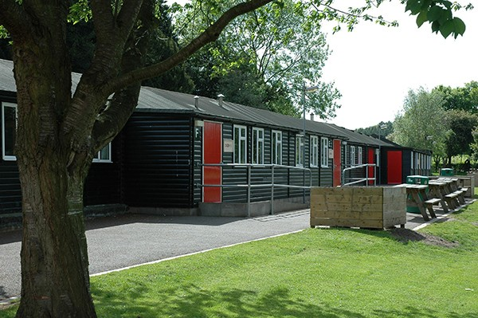
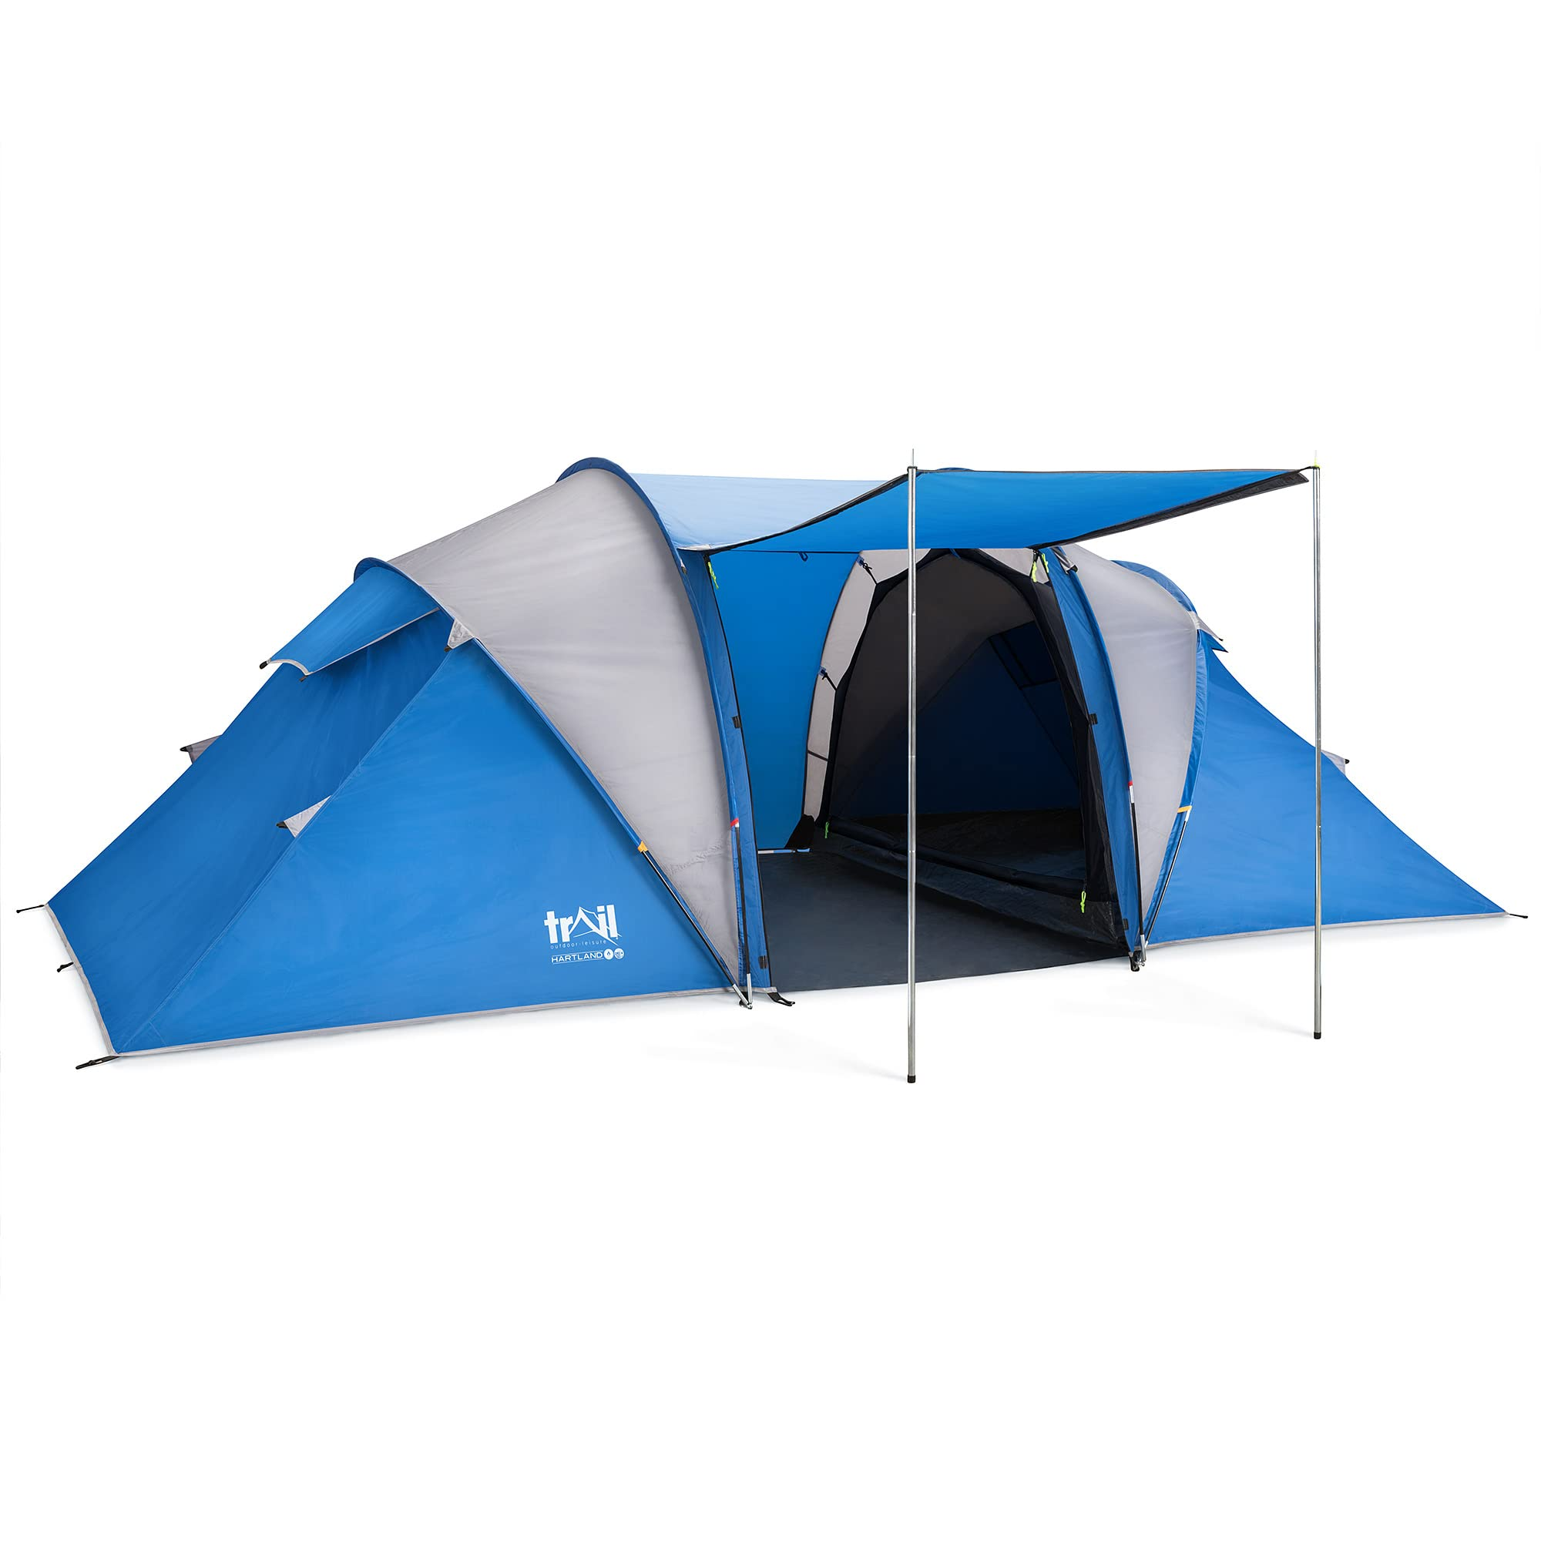
Accommodation

Slide 23
Tents
- 4-person tent, with 3 pupils sharing
- Space for pupils and belongings
- We’re limited to how much equipment the coach can carry

Slide 24
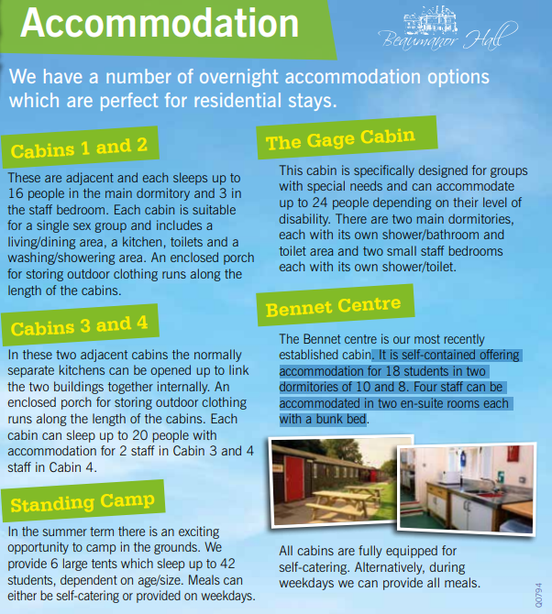
Cabins

Slide 25

What are Meals Times Like?
There are breakfast and dinner sittings. The sittings are organised based on their groups and it is important that students go to the correct sittings due to kitchen organisation and dietary requirements.
Breakfast:
Cooked breakfast options available.
Cereal, toast, juice etc.
Breakfast is a sitting, in the main hall.
Lunch:
Packed lunch with a variety of sandwich options, fruit, crisps and snacks.
Dinner:
Variety of dinner options throughout the week including pizza, sausage and mash, meatballs and pasta, burger and chips.
All meals are served with vegetables and desserts include fruit and yoghurt.
Dinner is a sitting, served in the main hall.
Vegetarian options/alternatives are available for every meal served.

Slide 26
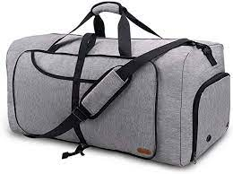



Packing and Kit
Residential kit
The tent! (If camping)
Sleeping bag
Pillow
If camping – Camping mat (no inflatable air beds)
Towel
Toiletries (e.g. shower gel, shampoo, toothpaste, toothbrush)
Underwear (plus spares!)
Torch
Nightwear
Trainers
Indoor shoes (e.g. sliders, dry trainers)
Sun hat
Sun cream
Plastic bags
Clothes for around site (non-activity clothes)
Gift shop money
Kit for activities
Tops/light weight t-shirts
Thermals or leggings/tracksuit bottoms/shorts
Sweatshirt/jumpers/fleece
Waterproof jacket
Waterproof trousers (optional)
Hat
Old trainers (that can get wet and/or muddy)
Wet shoes for canoeing (optional)
Clothes for the Disco
Personal protective equipment such as helmets and harnesses are provided.
Bags:
Everything should fit in one bag/holdall that the student is able to carry themselves.
They may wish to bring a small rucksack for the coach and for when they are out on activities.
Top tips!
Name everything! Including the bag!
Student should practice packing their bag (for the return home)
Bring carrier bags (for wet and muddy clothes!)
Students should pack their own bags, so they know where everything is when they arrive at Beaumanor!
Make sure you pack clothes for the disco!
Reminder:
We are going for a digital detox approach to Beaumanor!
Students should not bring their mobile phones with them.
Staff will have phones to contact home in an emergency

Slide 27
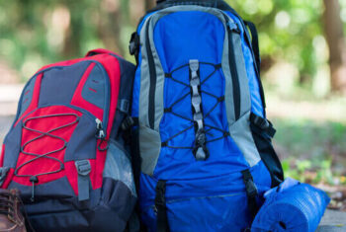
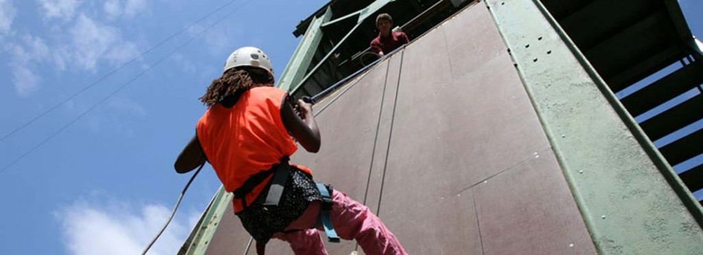
Residential Kit
Sleeping bag
Pillow
Toiletries
Towel
Nightwear
Underwear
Torch
Indoor shoes
Sun cream
Plastic bags!!!
Gift shop money
Notes:
Suncream:- we recommend factor 30 as a minimum requirement.
A rucksack is a good way to carry the sleeping bag – pack sleeping directly into the rucksack.

Slide 28
Kit for Activities
Recommended kit. No jeans for activities. They hold water when wet and do not dry off quickly enough.
No expensive clothing or fashion items. The clothes will get dirty, muddy, wet and smelly so old or not so special clothes are best
Tracksuit bottoms
Thermal / football tops / shorts
Sweatshirt / fleece
Waterproof jacket / trousers
Hat
Old trainers
Wellies
We provide personal protective equipment
Notes:
All specialist equipment is provided such as helmets and harnesses and children are shown how to put them on. Instructors always check that it is fitted correctly before the children start any activities.

Slide 29




What does a typical day look like?
Throughout the week, we will be doing all kinds of activities! These include archery, climbing, high ropes, canoeing, abseiling, bush craft, nightline, orienteering, bridge building and zip line!

Slide 30
What does a typical day look like?
Time | Event
7.15 – 9am | Breakfast sittings
9.15am – 12.15pm | Activity 1
12.15-1.15pm | Lunch
1.15pm – 4.15pm | Activity 2
4.45 – 5pm | Assembly
5.30 – 7.15pm | Dinner sittings
6.30 – 9.30pm | Evening activity (some days, for some groups)
9.30 – 10pm | Hot chocolate
10pm – 10.15pm | In tents, lights out at 10.15pm
There will be a briefing each day at 9am – 9.10am and then at 4.45pm-5pm. These will be held in the Bennett Cabin

Slide 31
Evening Activities
Murder Mystery
Cellars – Hide and Seek
Gym games
Campfire
Night Line
Final night talent show and disco!
Notes:
There is a small selection of evening activities form which the school will have selected:
Murder Mystery:
The group will do MM around the site, looking for clues to solve a mystery, inspired by the Victorian history of the house.
Cellars:
The group will play ‘Hide and Seek’ in the cellars. The session starts with some lights on, which are gradually dimmed. This activity enables children to overcome a fear of the dark This activity is usually a highlight of the trip.
Gym Games:
The children will play a selection of sport games in the gym or on the field – light and weather depending!
Campfire:
The children will sit around a campfire and play a few games. Visiting staff are more than welcome to lead singing round the campfire!
Night Line:
The night line is a rope trail running through our beautiful woodlands across numerous man-made obstacles. Participants follow the course blindfolded, meaning that other senses (and perhaps good communication from a sighted helper) must be relied upon to enable a safe and successful circuit of the course.

Slide 32
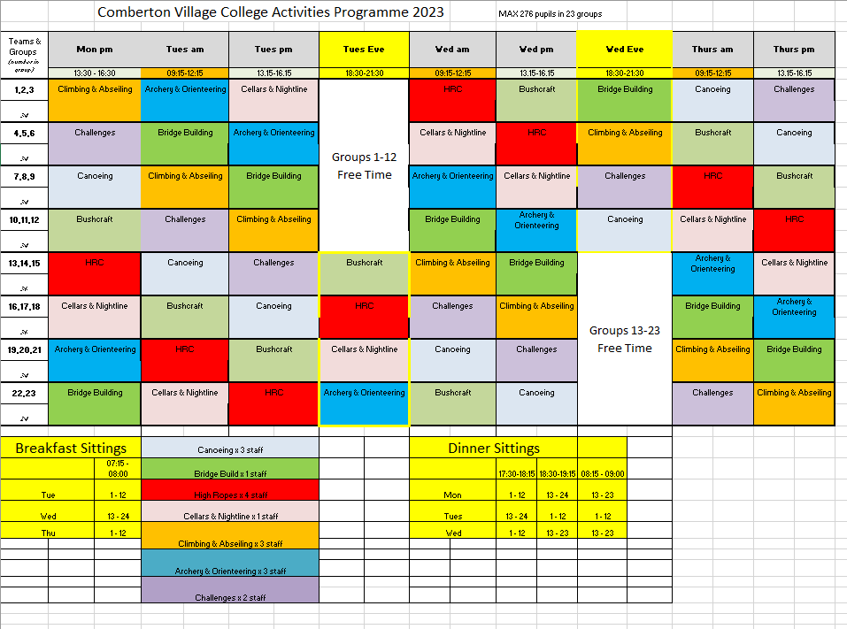
Example of Weekly Timetable from 2023

Slide 33

Arrival and Bag Drop
Please note that the information here is from last year’s trip; therefore, exact details are subject to change. We will confirm exact timings etc. closer to the time.
Arrival by school bus:
Pupils can arrive by school bus if needed
They should follow the instructions as explained once they arrive in school
Arrival by parent/carer drop off:
Pupils can be dropped off by parents/carers.
Must drop off in main car park, cannot drop off in bus lane
Drop off is between 7.45 – 8.25am
There will be significant numbers dropping off students so please do not stay after dropping off.
Bag drop and medication:
Once at school, students will need to drop their bag at their numbered coach zone. Their coach number can be found on One Note/Class Teams.
If your child has prescription medication, they will also need to drop their medication (in its original packaging and clearly labelled) to Mrs While-Paddon, our school nurse. This will be placed in a box, designated for each coach, to travel with them to Beaumanor. She will be at the front of school.
If your child has emergency medication, e.g. inhaler, epi-pen, the spare medication will need to be handed in to Mrs While-Paddon. Clearly named and instructions provided – ideally all placed in a small Tupperware box. Your child will then keep the main medication with them at all times.
Pupils should then go to their social area.

Slide 34

Registration and Bus Loading
Please note that the information here is from last year’s trip; therefore, exact details are subject to change. We will confirm exact timings etc. closer to the time.
After pupils have dropped their bags, they will need to wait in their social area.
Here they should check where they will be registering. Registration rooms will be put up in the social area. This is organised by form.
At 8.25am, students should go to their registration room and will be registered by a member of staff.
They will then be escorted down to their bus to get seated and registered on the bus
Leaving at 9.15am
We are due to arrive at Beaumanor for 11.30am and then the adventure begins!

Slide 35
Illness Prior to the Trip
This is a reminder that if a student has a temperature, vomiting or diarrhoea less than 48 hours to the leaving date, they should not attend the trip.
To ensure they are well enough to attend, they should be symptom free for 48 hours.
If this does occur, they can be dropped off at Beaumanor after their 48 hours if they wish to join after this period of time.
****
As with any absences, please contact the school via the main school phone line to let us know, prior to 8.30am.
We will have a medically trained professional accompanying us on the trip who will oversee medication and be hand in case of emergency.

Slide 36

Collection on Friday
Please note that the information here is from last year’s trip; therefore, exact details are subject to change. We will confirm exact timings etc. closer to the time.
We will be aiming to leave Beaumanor at 11.30am. Our estimated arrival time to Comberton is 1.30pm, to allow for delays in leaving.
You can collect your child from school on Friday but please note:
Collection from main car park from 1.30pm – 2.15pm
After 2.15pm, you will not be able to collect your child until 3pm to allow for other school collection to take place.
School buses:
Pupils can take their regular school bus home at 2.50pm
There will be supervision in school until this time
Medication that was handed in on Monday can be collected on Friday following the same process.

Slide 37

Thank you for listening
Any Questions…?
Mr M Knight, Head of Year 7
mknight@combertonvc.org
Ms Claire Cook, Year 7 Administrator
ccook@combertonvc.org

